Slide 1
Section 8.3 Infinite Geometric Series
i) Sums of an infinite geometric series
ii) Deriving the formula for the sum of an infinite geometric series
© Copyright all rights reserved to Homework depot: www.BCMath.ca

Slide 2
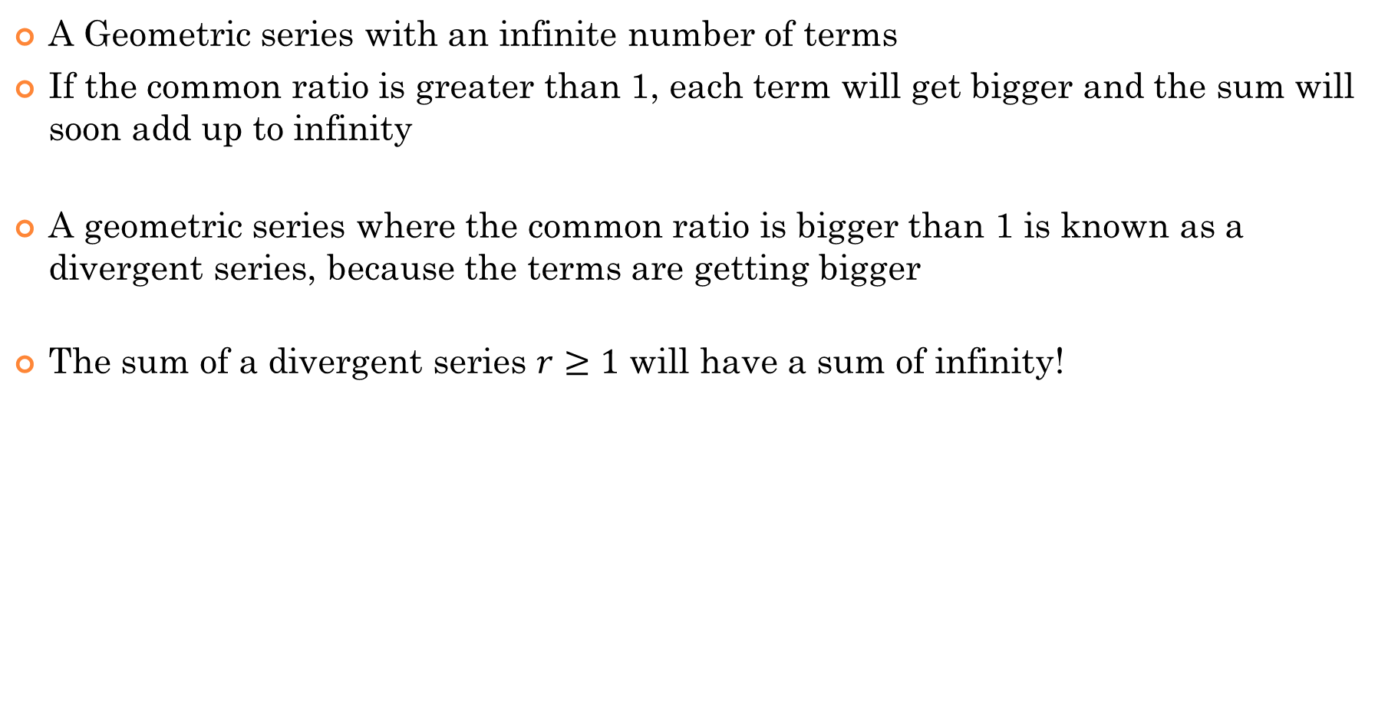
I) What is an Infinite Geometric Series?
A Geometric series with an infinite number of terms
If the common ratio is greater than 1, each term will get bigger and the sum will soon add up to infinity
A geometric series where the common ratio is bigger than 1 is known as a divergent series, because the terms are getting bigger
The sum of a divergent series $r≥1$ will have a sum of infinity!
Note: Any infinite G.S. with a common ratio $r≥1$ then the sum will add up to infinity (aka: Divergent Series)
© Copyright all rights reserved to Homework depot: www.BCMath.ca

Slide 3
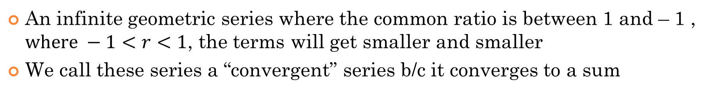
An infinite geometric series where the common ratio is between 1 and – 1 , $where −1<r<1$, the terms will get smaller and smaller
We call these series a “convergent” series b/c it converges to a sum
These values in this series will eventually become so small, such that adding them will be insignificant!! Ie: it’s like adding zeroes to a series…
The formula for the sum of an infinite geometric series when the common ratio is between 1 and -1

Slide 4
What happens if the ratio is less than -1?
If the common ratio is less than -1, two things will happen:
The terms will fluctuate between positive and negative
The terms will get bigger and bigger [absolute value of the terms]
The sum will also fluctuate between positive negative, depending on the number of terms
If you have an infinite number of terms, the sum can be either “positive” or “negative”
In this case, the sum of an infinite geometric series with r < -1 will be “INDETERMINATE”
Indeterminate, we don’t know which one it can be, the answer could be either one

Slide 5
Ex: Find the sum of the Infinite G.S.
Ex: The common ratio of an infinite geometric series is 0.75. If the sum of all the terms converges to 20, find the first term.

Slide 6
Ex: Find the sum of the Infinite G.S.
© Copyright all rights reserved to Homework depot: www.BCMath.ca

Slide 8
Ex: The common ratio of an infinite geometric series is 0.75. If the sum of all the terms converges to 20, find the first term.
© Copyright all rights reserved to Homework depot: www.BCMath.ca

Slide 9
II) Formula for the SUM of an Infinite G.S.
If the Ratio is bigger than 1, the sum will be positive infinity
If the ratio is smaller than -1, the sum will be negative infinity
If the Ratio is between 1 and -1, the sum can be obtained through a formula:
Formula for the sum of a G.S. with “n” terms
If there are infinite terms, then “n” will be infinity
Since
the value of
will reach zero
The equation will only apply if
© Copyright all rights reserved to Homework depot: www.BCMath.ca

Slide 10
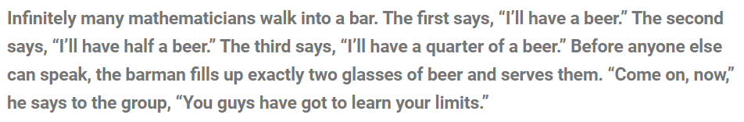
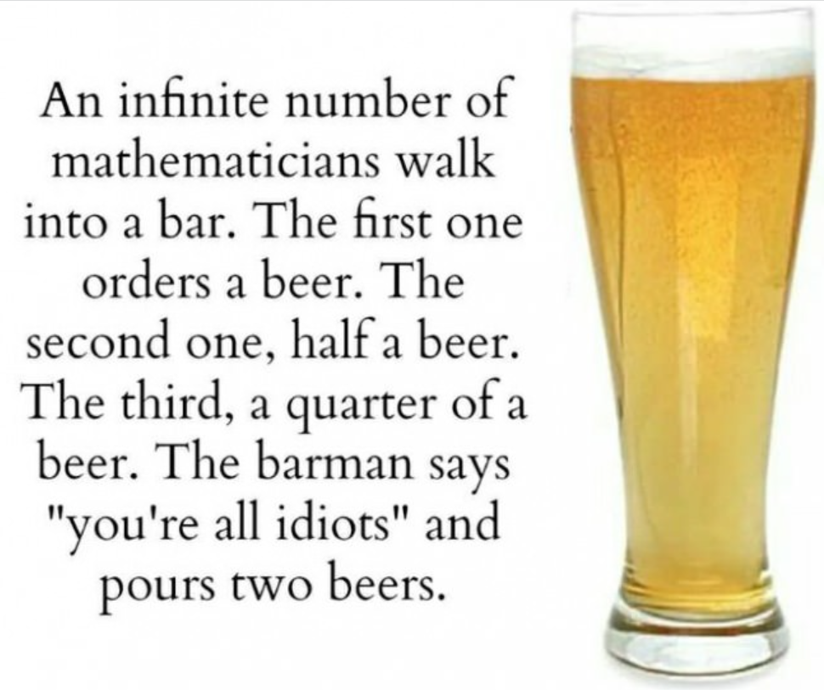

Slide 11
Here’s something to remember:
IF you are to find the sum of an infinite geometric series AND
i) The first term is 5 and the common ratio is 0.5
ii) The first term is 5 and the common ratio is $\frac{1}{3}$
iii) The first term is 5 and the common ratio is $\frac{1}{4}$

Slide 12
Given the following infinite geometric sequence, what should the value of “r” be so that the sum will be 20?
The series must be converging
So the value of “r” must be between -1 and 1
The answer must be r = 0.80
© Copyright all rights reserved to Homework depot: www.BCMath.ca

Slide 13
Ex: The sum of an infinite geometric series is 360 and it’s common ratios is 2/5. What is the value of the first term? Write the first three terms of the series:
Ex: The sum of an infinite geometric series given below is equal to 4. What is the value of “x”? List the first three terms of the series:
b) For what values of “x” in the series above will it be a convergent series?
b) For what values of “x” in the series above will it be a divergent series?

Slide 14
Ex: The sum of an infinite geometric series is 360 and it’s common ratios is 2/5. What is the value of the first term? Write the first three terms of the series:

Slide 15
Ex: The sum of an infinite geometric series given below is equal to 4. What is the value of “x”? List the first three terms of the series:
b) For what values of “x” in the series above will it be a convergent series?
b) For what values of “x” in the series above will it be a divergent series?

Slide 16
Ex: a movie in a theatre generate $250,000 in revenue in the first month of its showing. Each month, sales from that movie drop by 15%. If the movie is shown for a long time, what is the total revenue generated?
Given that

Slide 17
Ex: a movie in a theatre generate $250,000 in revenue in the first month of its showing. Each month, sales from that movie drop by 15%. If the movie is shown for a long time, what is the total revenue generated?
Keep in mind that the common ratio “r’ is the percentage that you keep!
If you lose 15%, you keep 85% !!
© Copyright all rights reserved to Homework depot: www.BCMath.ca

Slide 19
Given that

Slide 20
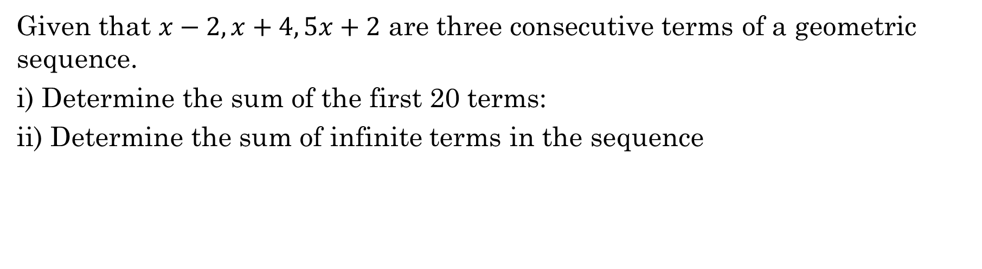
Given that $x−2, x+4, 5x+2$ are three consecutive terms of a geometric sequence.
i) Determine the sum of the first 20 terms:
ii) Determine the sum of infinite terms in the sequence

